Slide 1
Mechatronics
- Introduction -

Slide 2
What is Mechatronics?
The word Mechatronics is composed of “mecha” from mechanical and the “tronics” from electronics.
Mechanical + Electronics = Mechatronics
The term mechatronics was coined by Tetsuro Mori, a senior Japanese engineer at Yasakawa Company in 1969.
Mechatronics is synergic integration of mechanical engineering, electronics engineering, control engineering and computer science.
A mechatronic system is a computer controlled mechanical system.

Slide 3
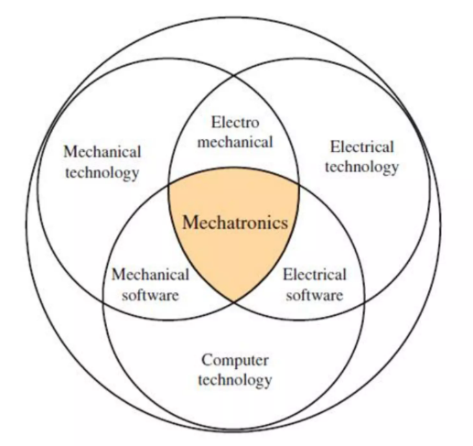

Slide 4
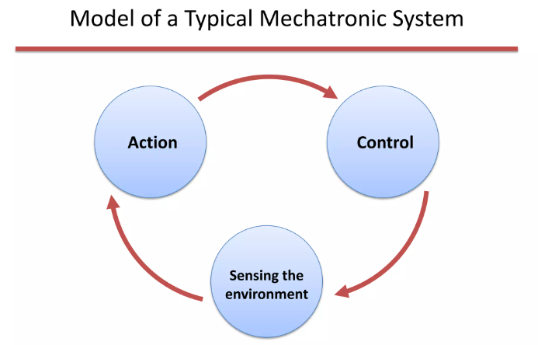

Slide 5
Modules of a Mechatronic System
1. Sensing
(a) Sensors
(b) Signal Conditioning
(c) Analog-to-Digital and Digital-to-Analog Conversion
2. Control
(a) Open Loop and Closed Loop Control
3. Action
(a) Drive Circuits
(b) Actuators
(c) Motors

Slide 6
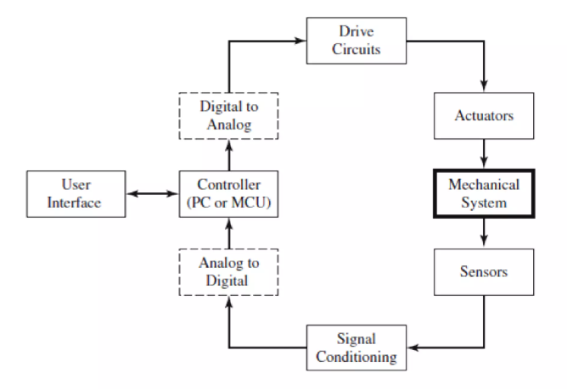

Slide 7
Components of a Mechatronic System
Mechanical
Electronics
Sensors
Actuators
Control
Computing

Slide 8
Components of a Mechatronic System
A mechatronic system has at its core a mechanical system which needs to be commanded or controlled by a controller.
The controller needs information about the state of the system. This information is obtained from sensors.
In many cases, the signals produced by the sensors are not in a form ready to be read by the controller and need some signal conditioning operations performed on them.
The conditioned, sensed signals are then converted to a digital form by Analog-to-Digital Convertor (ADC) and are then sent to the controller.

Slide 9
Components of a Mechatronic System
The controller is the ‘mind' of the mechatronic system, which processes user commands and sensed signals to generate command signals to be sent to the actuators in the system.
Actuators are devices that can convert electrical energy to mechanical energy.
The user commands are obtained from a variety of devices including command buttons, graphical user interfaces (GUIs), touch screens, or pads.

Slide 10
Basic elements of control system
A control system consists of several elements where each element performs a particular task.
These elements are connected in proper sequence and facilitates signal to flow through them
Different control actions are performed by these elements to obtain a desired output.
Basic elements of control system depends upon the type of control system.
Main types of control system are:
A. open loop control system and
B. closed loop control system

Slide 11
Open & Closed Loop System
In some cases, the command signals are sent to the actuators without utilizing any feedback information from the sensors. This is called open-loop system, and for it to work, this requires a good calibration between the input and output of the system.
The more common mode of operation is the closed-loop mode in which the command signals sent to the actuators utilize the feedback information from the sensors. This mode of operation does not require calibration information.

Slide 12
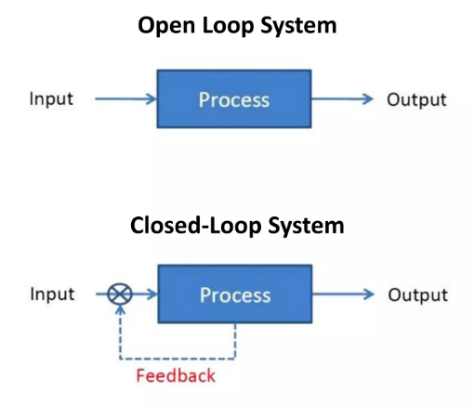

Slide 13
Open loop control system
Open loop system is a control system in which the output is dependent on the input but the input or controlling action is independent of the output or change in the output.
It is relatively simple, low cost, easy to understand and maintain stability and reliability is relatively good.
Its disadvantages are inaccuracy, slow in response, no optimized control.

Slide 14
Closed loop system
The disadvantages of open-loop systems, namely sensitivity to disturbances and inability to correct for these disturbances, may be overcome in closed-loop systems.
The closed-loop system compensates for disturbances by measuring the output response, feeding that measurement back through a feedback path, and comparing that response to the input at the summing junction.
Closed-loop systems, then, have the obvious advantage of greater accuracy than open-loop systems. They are less sensitive to noise, disturbances, and changes in the environment.

Slide 15
Introduction to Mechatronics
Every computer controlled system has four basic functional blocks:
1. A process to be controlled
2. Sensors
3. Actuators
4. Controller

Slide 16
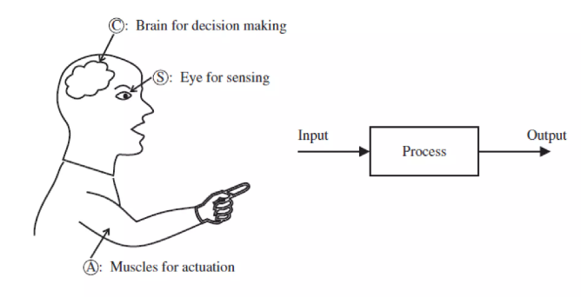
Introduction to Mechatronics
The analogy between a human controlled system and computer control system is shown in figure.

Slide 17
Introduction to Mechatronics
If a process is controlled and powered by a human operator, the operator observes the behavior of the system (i.e. using visual observation), then makes a decision regarding what action to take, then using his muscular power takes a particular control action.
One could view the outcome of the decision making process as a control or decision signal, and the action of the muscles as the actuator signal which is the amplified version of the control (or decision) signal.

Slide 18
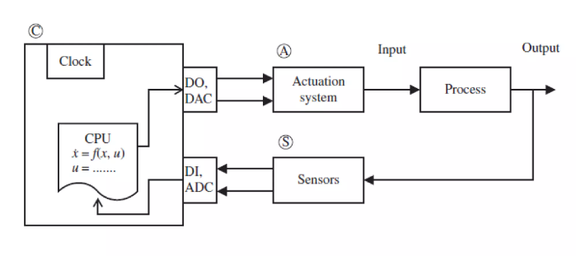
Introduction to Mechatronics
The same functionalities of a control system can be automated by use of a digital computer as shown in the figure.

Slide 19
Introduction to Mechatronics
The sensors replace the eyes, the actuators replace the muscles, and the computer replaces the human brain
Every mechatronic system has some sensors to measure the status of the process variables
The sensors are the "eyes" of a computer controlled system
Actuators are the "muscles" of a computer controlled system

Slide 20
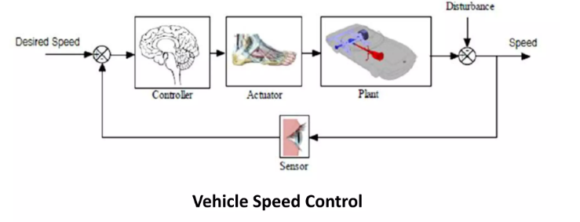

Slide 21
Applications
Smart consumer products: home security, camera, microwave oven, toaster, dish washer, laundry washer-dryer, climate control units, etc.
Medical: implant-devices, assisted surgery, haptic, etc.
Defence: unmanned air, ground, and underwater vehicles, jet engines, etc.
Manufacturing: robotics, machines, processes, etc.
Automotive: climate control, antilock brake, active suspension, cruise control, air bags, engine management, safety, etc.

